Slide 1

DEPARTMENT OF INFORMATION SCIENCE & ENGINEERING
“PNEUMONIA DETECTION USING DEEP LEARNING”
Presentation by,
NAME: Dhanush Biligiri N H
USN: 1NH18IS030
Under the Guidance of ,
Guide Name: Prof. Saravanan
Designation

Slide 2
Agenda
Introduction
Problem Definition
Objectives
Proposed system
Methodology
Expected Outcome
Conclusion

Slide 3
Introduction
Deep learning is an artificial intelligence(AI) function that imitates the working of the human brain in processing data and creating patterns for use in decision making. Deep learning is a subset of machine learning in AI that has networks capable of learning unsupervised from data that is unstructured or unlabelled. Also known as deep neural learning or deep neural network
Pneumonia is a form of acute respiratory infection that affects the lungs. The lungs are made up of small sacs called alveoli, which fill with air when a healthy person breathes. When an individual has pneumonia, the alveoli are filled with pus and fluid, which makes breathing painful and limits oxygen intake.
The risk of pneumonia is immense for many, especially in developing nations where billions face energy poverty and rely on polluting forms of energy. Due to the current rise of the COVID-19 pandemic, it is observed that people who are pneumonic are more prone to the virus than others.

Slide 4
Problem Definition
Over 150 million people get infected by pneumonia on an annual basis especially children under the age of 5 years. Pneumonia is the world’s deadliest child killer claiming one young life every 39 seconds. The disease is preventable but still has a major effect than any other infection. This disease become more deadly as the germs that cause it is contagious
This project aims at collecting and pre-processing the X-ray images from a dataset and creating a model for training and validating the dataset. The goal Is to separate the positive and negative pneumonia reports and be extremely accurate with the results. This project is implemented on the anaconda platform.

Slide 5
Objectives
The objective of this project is to fetch raw data and train it in the Anaconda software and finally testing the accuracy of the program.
To successfully segregate the pneumonic and non-pneumonic X-Rays.

Slide 6
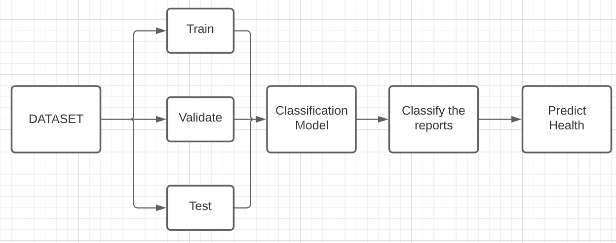
Proposed System-Architectural Design of the System

Slide 7
Proposed System- Methodology
A dataset consisting of X-ray Images is split into 3 datasets(Training dataset, Validate dataset, Test Dataset)
System Requirements: Python, Anaconda, Jupyter Notebook
The Different datasets are trained to segregate the Pneumonic images from the Non-Pneumonic images.
This is then validated and tested on another set images to predict whether the images are Pneumonic or Non-Pneumonic

Slide 8
Expected Outcome
The model segregates the images and produces an accuracy of 91%. The accuracy is determined using confusion matrix and the output is tabulated.

Slide 9
Conclusion
Over 150 million people get infected by pneumonia on an annual basis especially children under the age of 5 years. Pneumonia is the world’s deadliest child killer claiming one young life every 39 seconds. So it is mandatory to come up with an algorithm that will help in detecting Pneumonia.
Ensuring that the algorithm works accurately will be our utmost concern.

Slide 10
References
[1] allenkong221/pneumonia-detection-resnet - Jovian
[2] Kaggle Datasets

Slide 11
Thank you
Queries ?

